Slide 1

Student Centered Model (NFM)
Need
Program Cost
Income
Funding Agencies
HELB: Loan for Tuition and Upkeep,
Both Universities and TVET
UF: Scholarship for Tuition,
Public Universities only
SDTVET: Scholarship for Tuition,
MoE-TVET only
Main Characteristics
Variable scholarship & Loan
Student must apply for both Scholarship/Loan
Funding based on need (5)
Tuition based on program cost
Money follows the student

Slide 2
What’s new= From Institutional Student Centered
Old
New
1
Placement=GoK funding
Delink Placement & Funding
2
Uniform grant
Funding-based need level
3
DUC Tuition
Actual Cost Funding
4
80/20 Cost sharing
Varied GoK Funding
5
University Funding
Student Funding

Slide 3
Student Centred Model - University
95% GoK Financing
90% GoK Financing
80% GoK Financing
70% GoK Financing
60% GoK Financing
Band 1
Scholarship-70%
Loan-25%
Household-5%
Band 2
Scholarship-60%
Band 3
Scholarship-50%
Loan-30%
Household-10%
Loan-30%
Household-20%
Band 4
Scholarship-40%
Loan-30%
Household-30%
Band 5
Scholarship – 30%
Loan – 30%
Household – 40%
Upkeep – Kshs.60,000
Upkeep – Kshs.55,000
Upkeep – Kshs.50,000
Upkeep – Kshs.45,000
Upkeep – Kshs.40,000

Slide 4
Student Centred Model - TVET
92.5% GoK Financing
88% GoK Financing
82% GoK Financing
78% GoK Financing
73% GoK Financing
Band 1
Scholarship-70%
Loan-22.5%
Household-7.5%
Band 2
Scholarship-60%
Band 3
Scholarship-50%
Loan-28%
Household-12%
Loan-32%
Household-18%
Band 4
Scholarship-40%
Loan-38%
Household-22%
Band 5
Scholarship – 30%
Loan – 43%
Household – 27%
Upkeep – Kshs.18,600
Upkeep – Kshs. 17,600
Upkeep – Kshs. 15,600
Upkeep – Kshs. 14,600
Upkeep – Kshs. 13,600

Slide 5
First Time Application Eligibility

Slide 6
Undergraduate Scholarship and Loan Eligibility
Both Scholarship & Loan: Kenyan students placed in public universities by KUCCPS (2022 and 2023 KCSE cohorts)
A student must express interest by making funding request through application for consideration
Loan only: Self-sponsored students in public universities and students in private universities.
Students under the Old Funding Model
Make your application on time, before you report to your university

Slide 7
First Time Application

Slide 8
1) Your valid email address (ensure you can login to your email)
2) Your telephone number.
3) Your KCPE index number and year of examination.
3b)Copy of the sponsorship letter (in PDF) if you were sponsored in Primary school.
4) Your KCSE index numbers and year of examination
4b) Copy of the sponsorship letter (in PDF) if you were sponsored in Secondary school.
5) Your University/College admission number
6) Your passport size photo (in jpeg/jpg/png format).
7) Copy of your National ID/Maisha card (both sides in PDF).
7b) Your Birth certificate in PDF (if you are under 19 years of age and don’t have an ID)
8) Your valid bank account number or MPESA number (registered in your name).
9) Your parents’ National IDs and registered telephone number.
9b) Copy of your parent(s) death certificate if deceased (in PDF).
10) Two guarantors’ ID numbers and registered telephone numbers (can be your parents).
Before you start application!
Ensure you have the following with you:
Requirements

Slide 9
Have the following in soft copies (on your computer)
Passport size photo
National ID/ Maisha Card
Birth Certificate
(if under 19years with no ID).

Slide 10
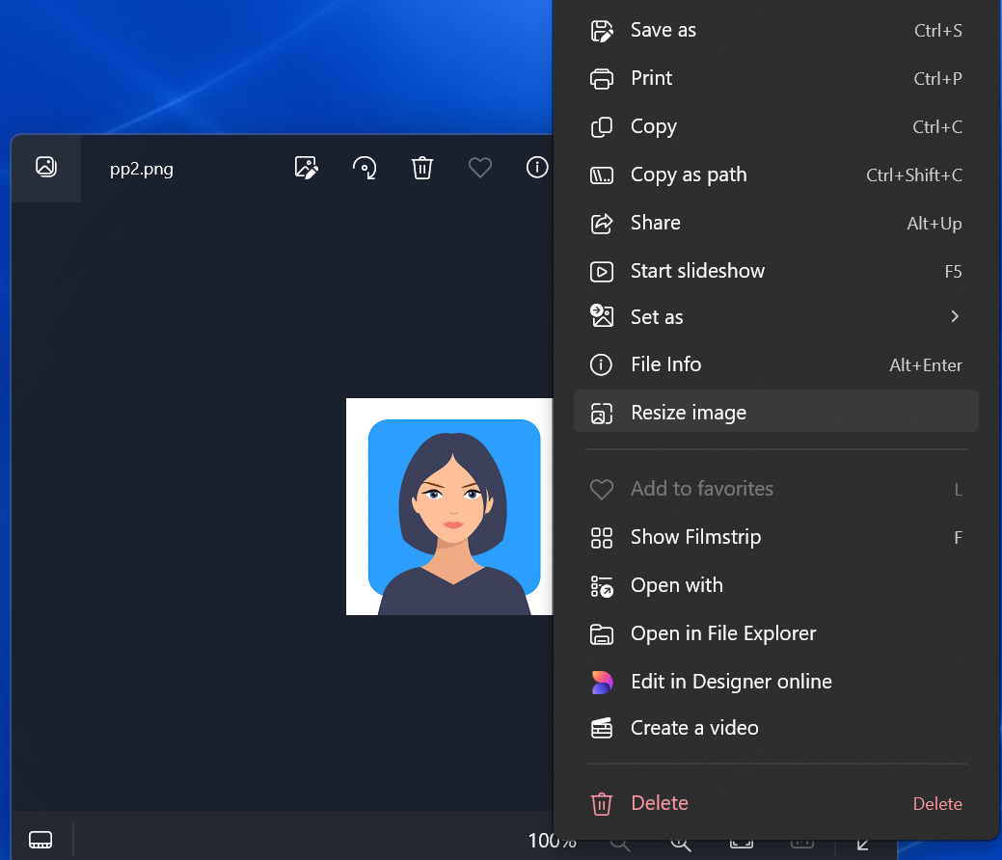
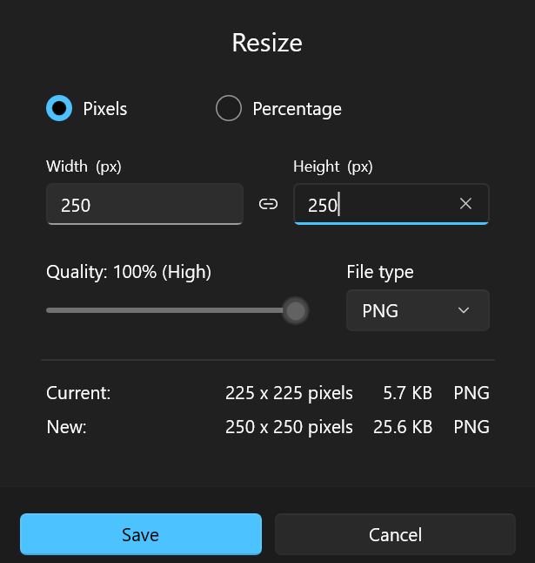
How save your Passport size photo
Take a passport size picture of your self
Save on computer
Open the picture
Right click picture
Select on “Resize”
Enter “250” on height of the picture
Save the picture in your computer

Slide 11
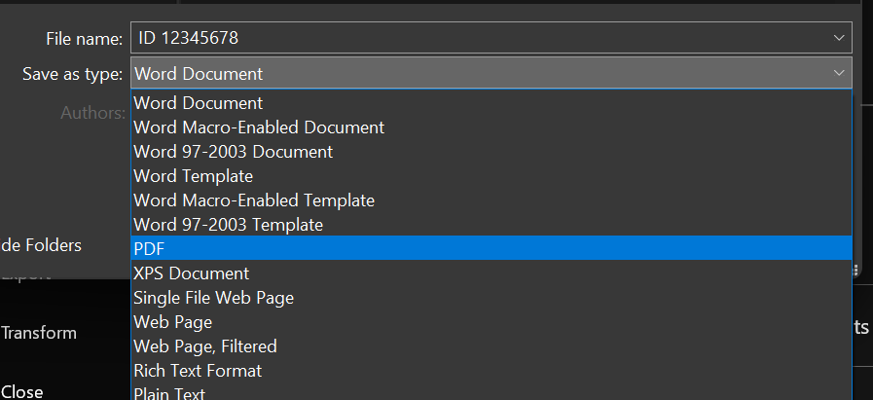
How to save your National ID or Birth Certificate
Take a clear picture of your original National ID/Maisha Card/Birth Certificate
Save picture on your computer
Copy the picture
Open word document on your computer
Paste the picture on the word document (in one page)
Save the document as pdf

Slide 12

Click here to apply

Slide 13
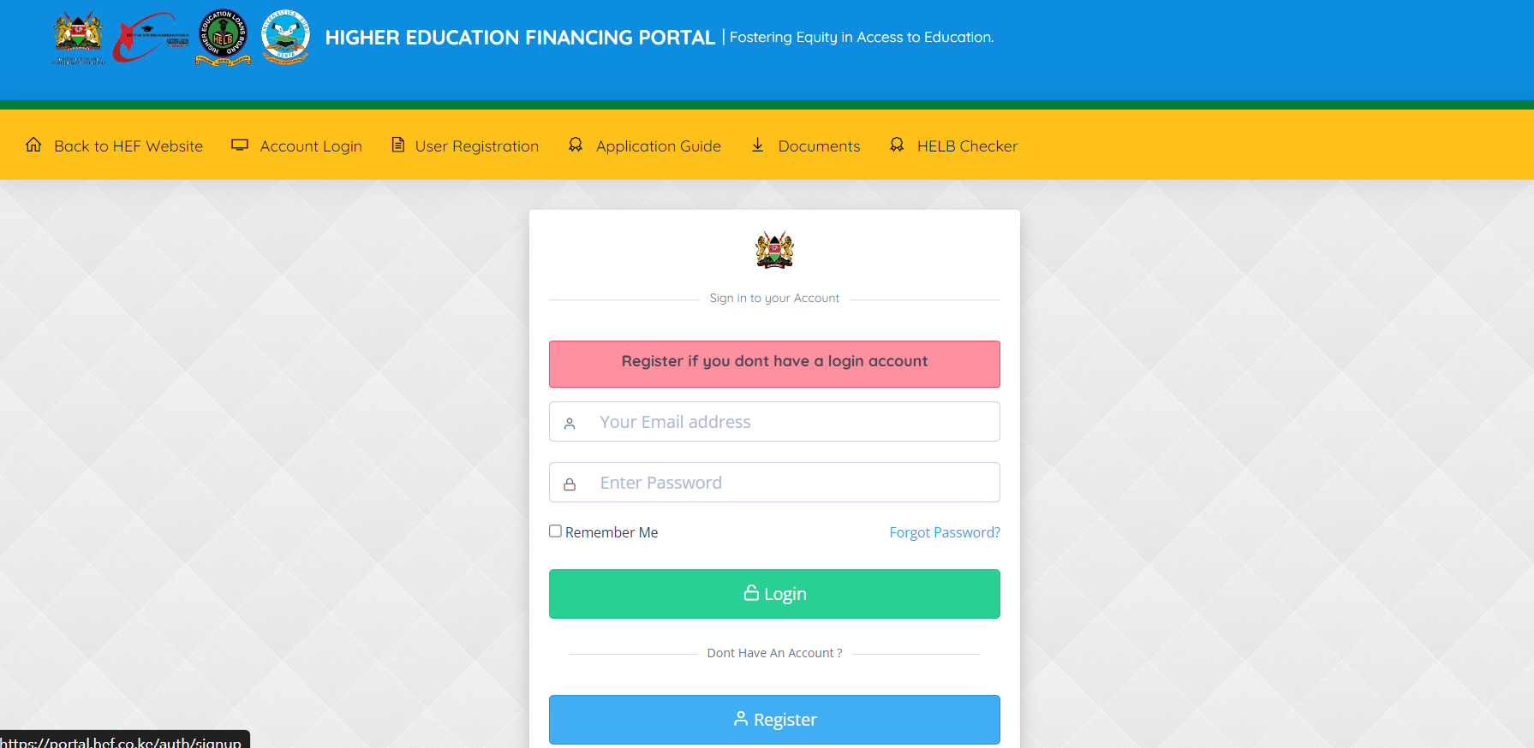
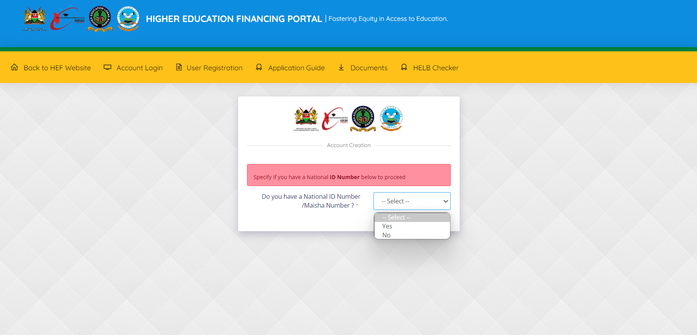
Specify if you have ID
Click to register

Slide 14
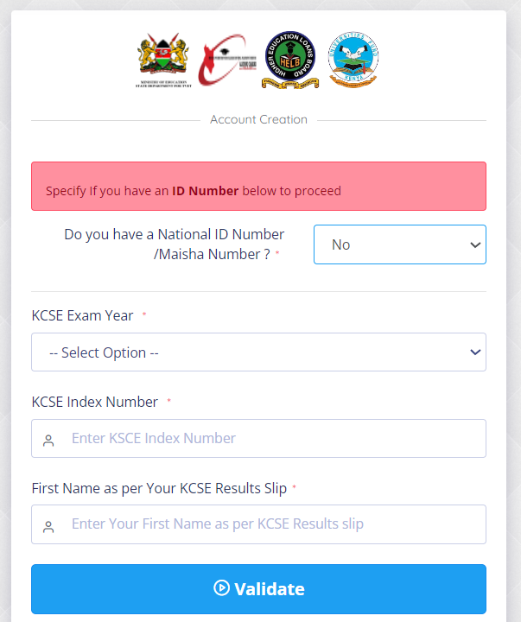
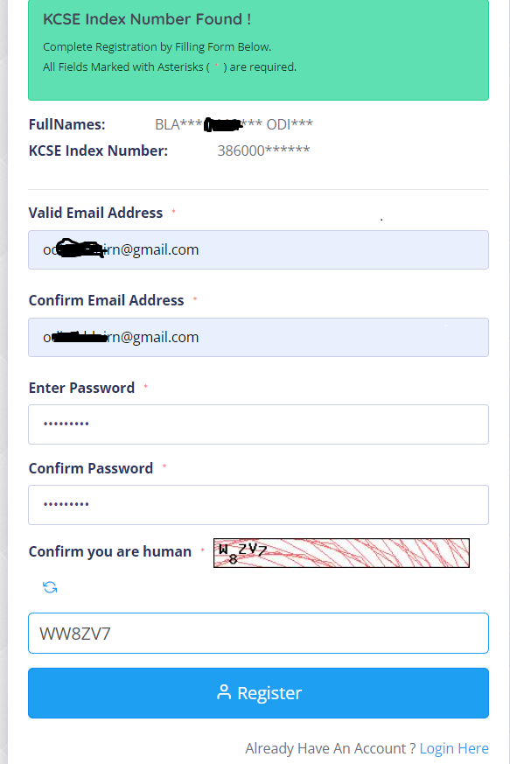
Enter your email address
Select exam year
Re-enter your email address
Enter your password (letters and numbers only)
Enter KCSE index number
Re-enter your password
Enter 1st name
Enter captcha code
Click register
Activation link will be sent to your email (Check inbox/Spam/Junk)

Slide 15
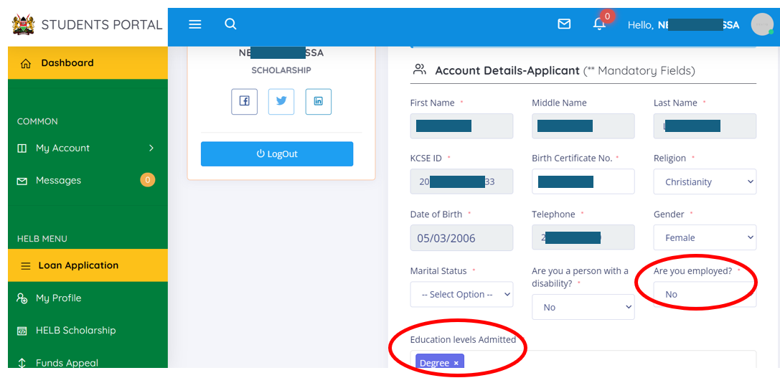
Controls access

Slide 16
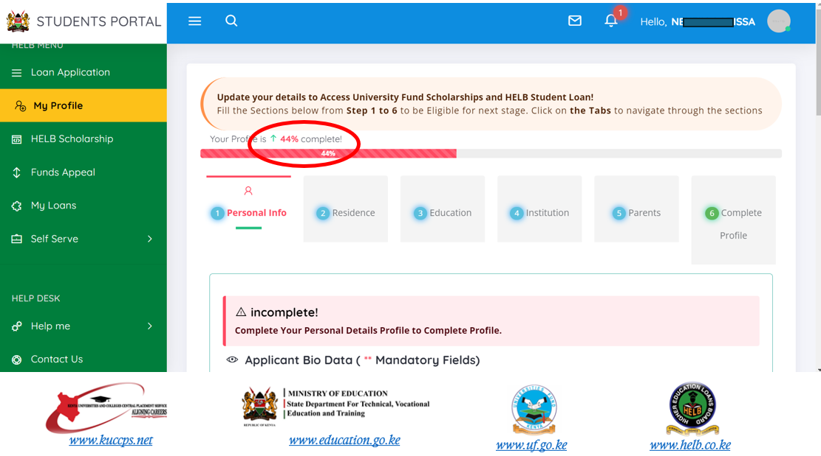
You must complete your profile to 100% to access application

Slide 17
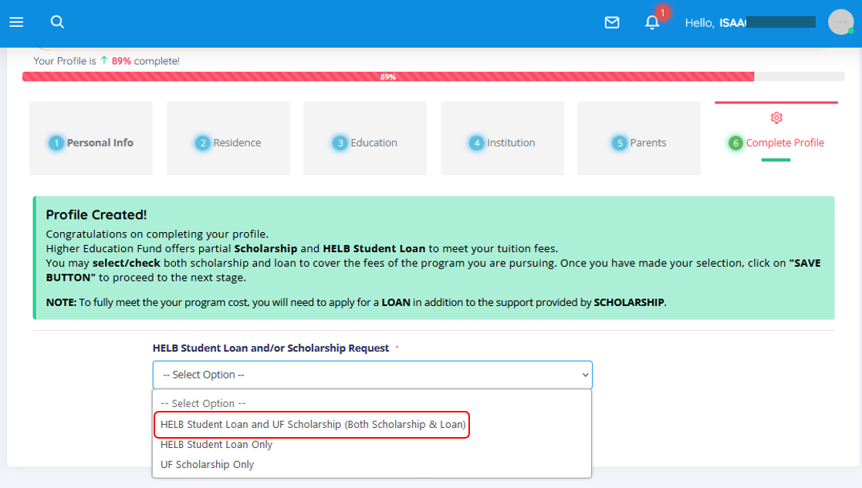
Click on the dropdown arrow to select your type of application
For greater GoK financial aid, its recommended to select on both Scholarship & Loan

Slide 18
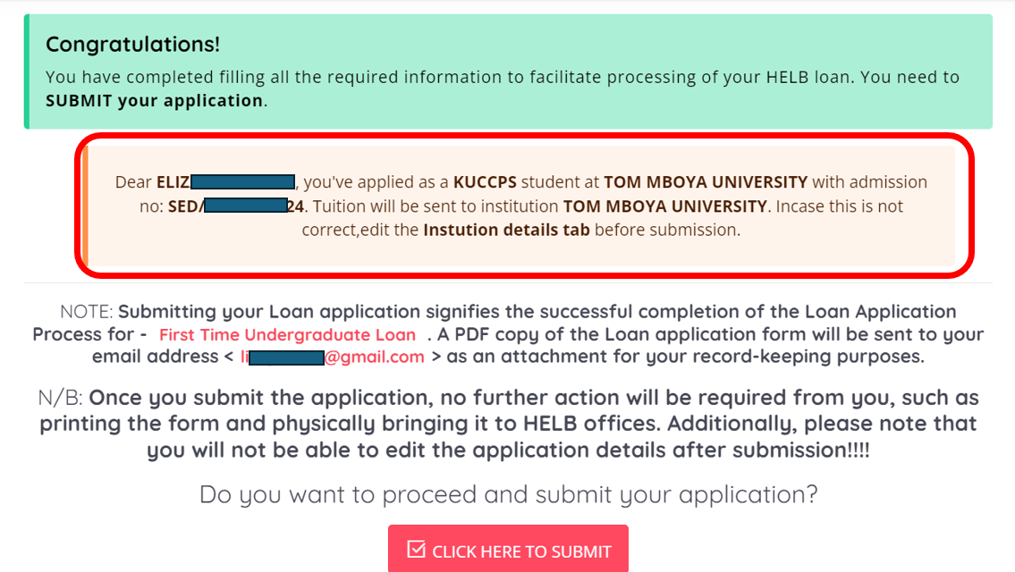
Do not click submit before reviewing your details!

Slide 19
Subsequent Application

Slide 20
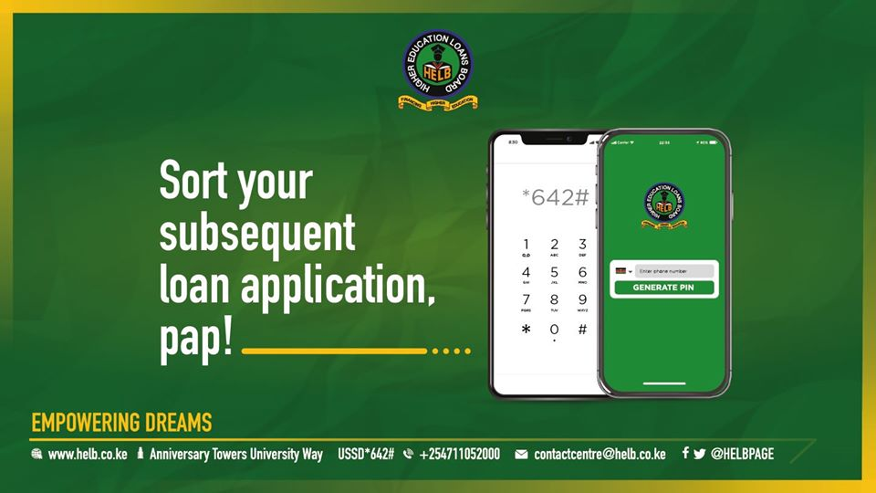

Subsequent Applications on Mobile
*642#

Slide 21
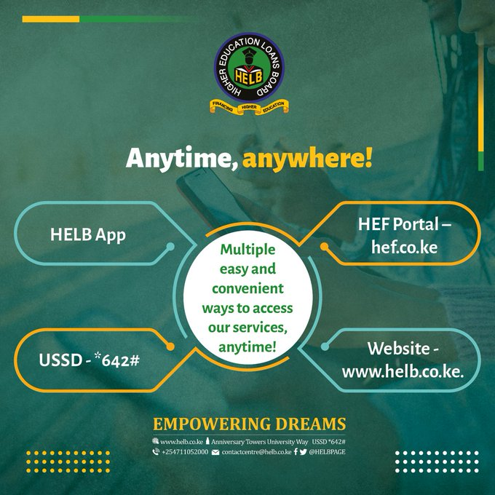
Applied for a loan/scholarship?
Track it via

Slide 22
Funds Appeal

Slide 23
Funds Appeal
Must have applied for both scholarship and Loan Only new information is considered Only those in band 2 – 5 can appeal

Slide 24
Application Review (Appeal)- Customer Journey
Log-in
Select Reason
Evidence
Submit
1
2
3
4
Visit www.hef.co.ke and log-in
Select reason for review
Attach evidence
Submit application online.

Slide 25
Partnership with Universities
Returns
Data Sharing
04
Return unutilized funds promptly
File HELB annual returns on time
Student nominal rolls
Deceased students
Opening dates
03
Allocation of Disbursed Funds
Product Uptake
02
Receipt of funds received
Distribute funds to students promptly
01
Mobilizing and assisting students with the applications

Slide 26
Q & A

Slide 27


